Slide 1

RCS Green
Theatre Checklist
E-Quip series
Reducing water consumption
in hand decontamination

Slide 2
Rub don’t scrub
Switching to waterless alcohol-based hand
rub for surgical scrubbing

Slide 3

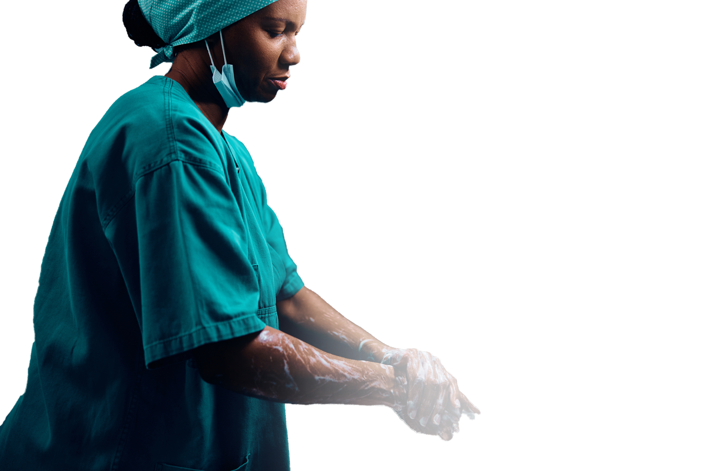
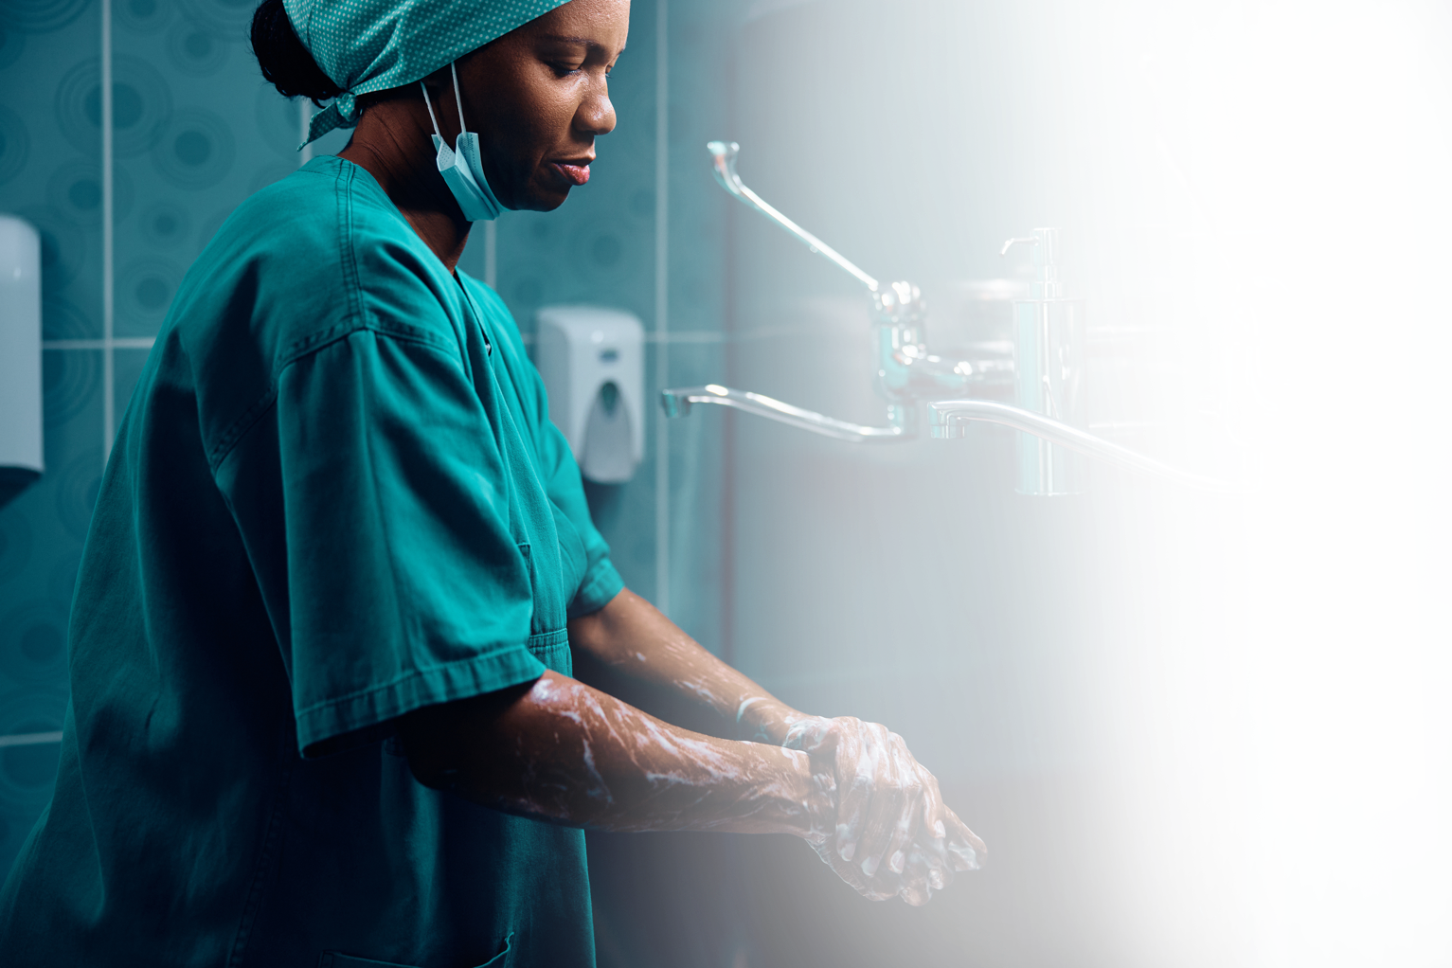
Background
Alcohol-based hand rub is a water-free alternative to surgical scrubbing and is approved by NICE and WHO^{1,2}
A formal surgical scrub can use up to 18 litres of water per person!³
With current consumption patterns, 2/3 of the world’s population could be living in water stressed countries by 2025⁴
There are no differences in SSI with ABHR versus formal scrubbing^{5,6}, and it has been found to be better tolerated
by surgeons⁷
Notes:
References
1. NICE 2020. Surgical site infections: prevention and treatment (NG125). Available at: https://www.nice.org.uk/guidance/ng125
2. World Health Organisation 2009. WHO Guildeines on Hand Hygeine in Health Care. Available at: https://www.who.int/publications/i/item/9789241597906
3. Wormer BA, Augenstein VA, Carpenter SL, et al. The green operating room: simple changes to reduce cost and our carbon footprint. Am Surg 2013; 79: 666–671.
4. United Nations Department of Economic and Social Affairs (UNDESA) 2015. International Decade for Action ‘Water for Life’; Water and Sustainable Development. Available from: https://www.un.org/waterforlifedecade/water_and_sustainable_development.shtml
5. Parienti JJ, Thibon P, Heller R, et al. Hand-rubbing with an aqueous alcoholic solution vs traditional surgical hand-scrubbing and 30-day surgical site infection rates: a randomized equivalence study. JAMA 2002;288(6):722-727.
6. Tanner J, Dumville JC, Normal G, Fortnam M. Surgical hand antisepsis to reduce surgical site infection. Cochrane Database of Systematic Reviews 2016; 1: Article CD004288
7. Lopes AER, Menegueti MG, Gaspar GG, et al. comparing surgeons’ skin tolerance and acceptability to alcohol-based surgical hand preparation vs traditional surgical scrub: a matched quasi-experimental study. Am J Infect Control 2020;50(10):1091-1097.

Slide 4
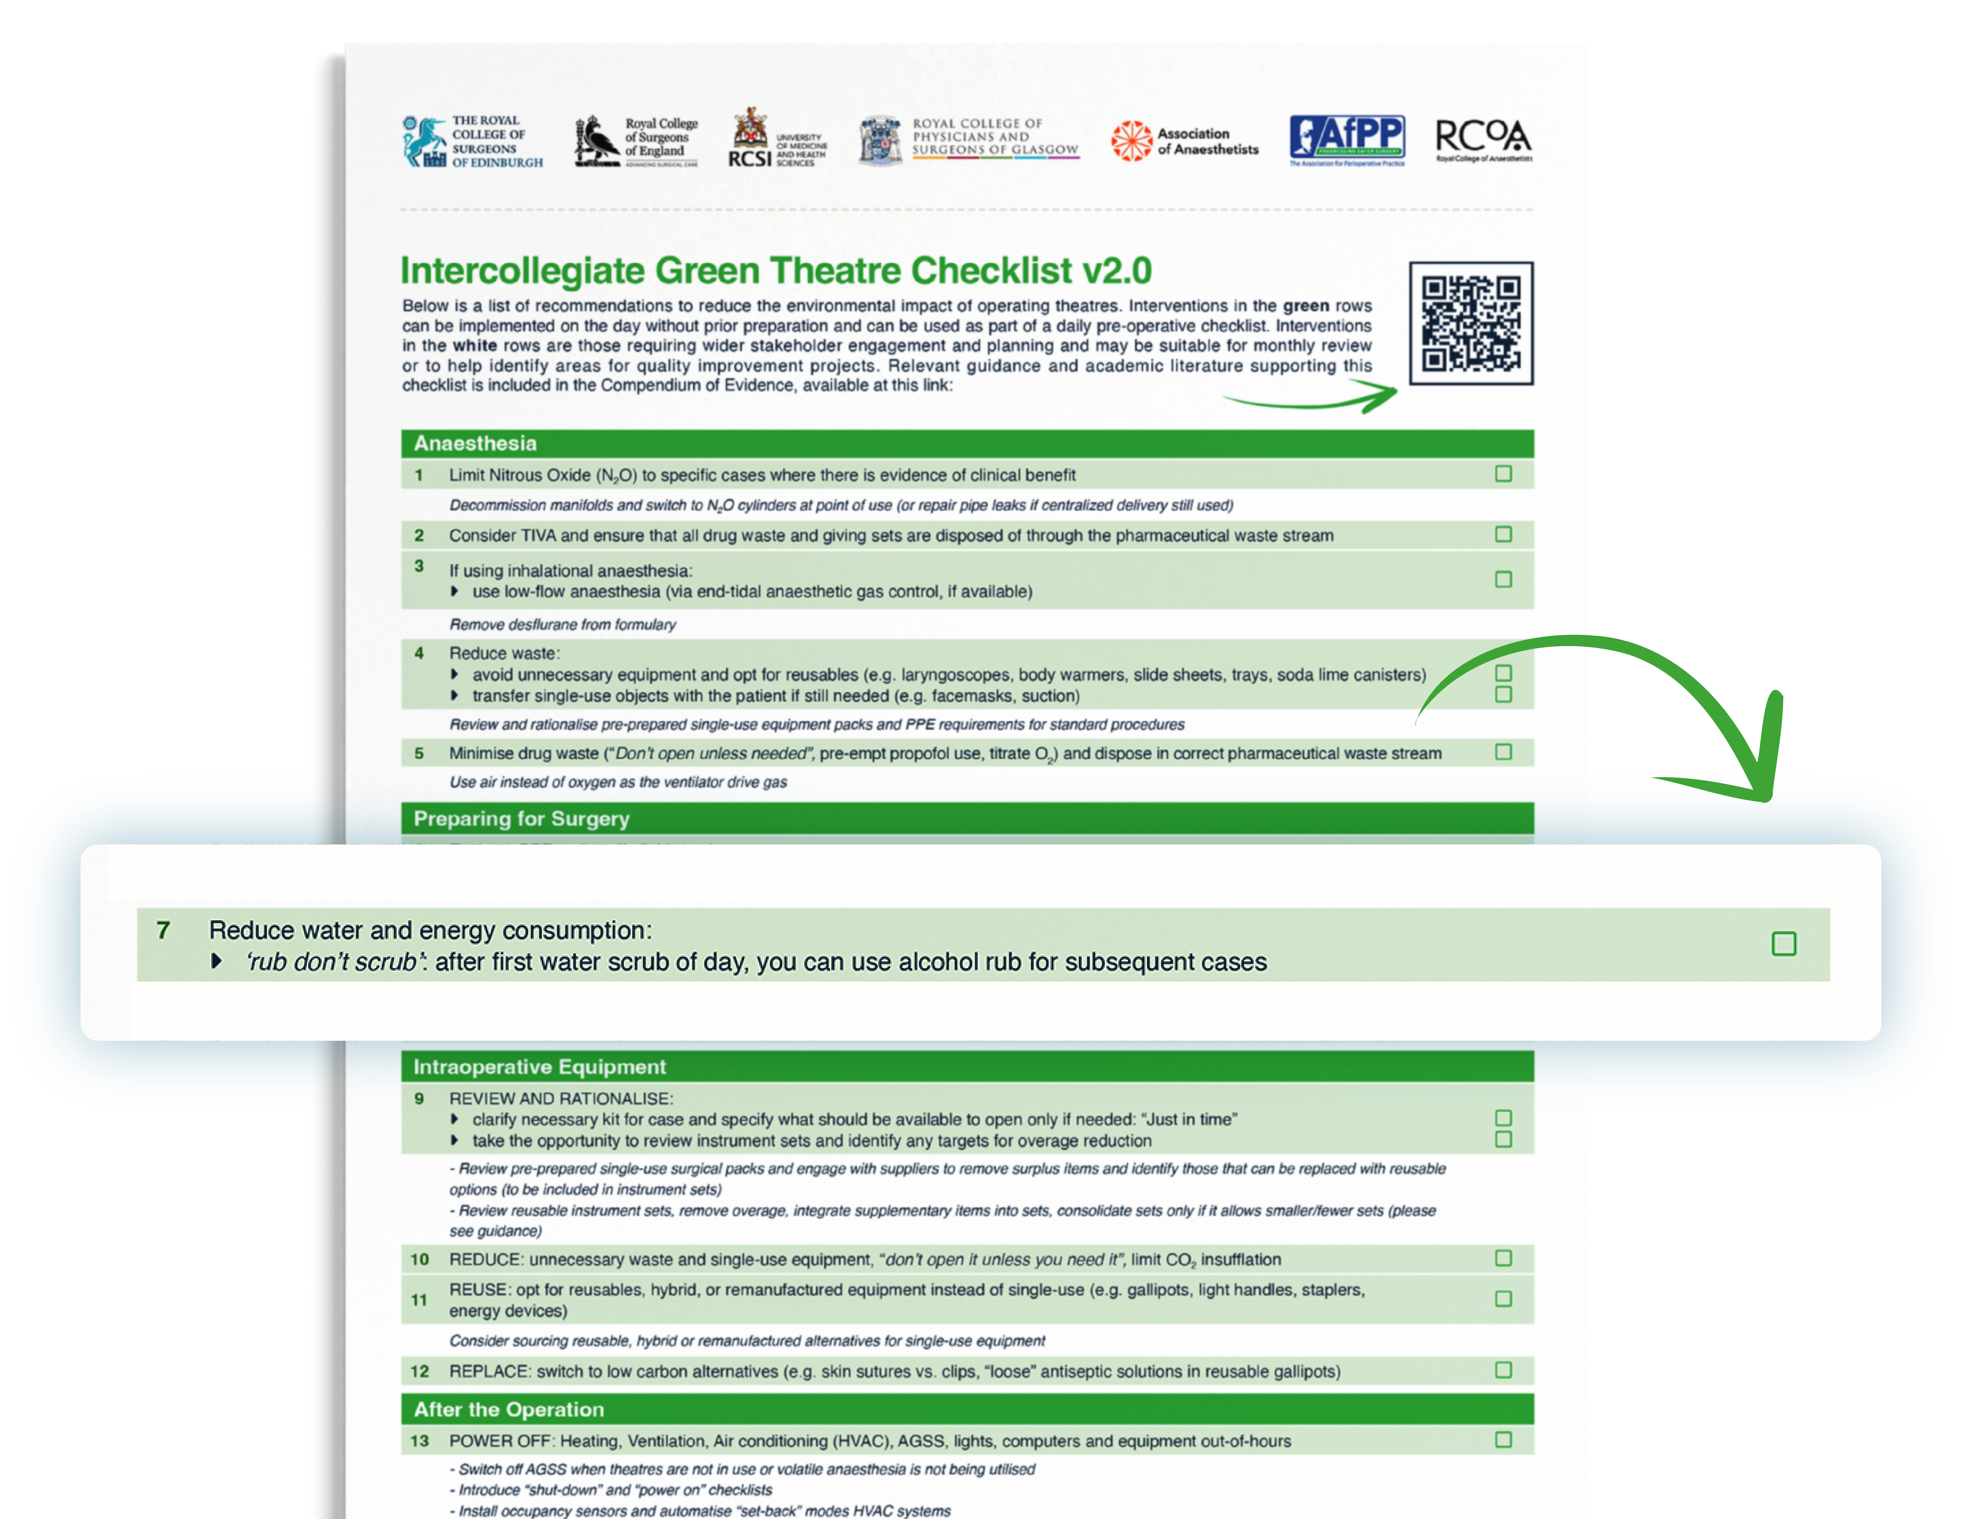

Slide 5

Baseline Audit | Basic
XX(XX%)
used water-based
hand washing
XX(XX%)
used ABHR
XXXX including XXXX
operating cases scrubbing episodes
This amounted to
XXXX litres of water
average XXX per case
Over a year in this theatre department,
this represents
XXXX litres of water
Notes:
Delete this slide (BASIC AUDIT) or next one (ADVANCED AUDIT) as required on basis of what model was used.
BASIC BASELINE AUDIT
Data for the blank spaces (boxes left to right from top) FOUND ON TAB 1 OF THE SPREADSHEET, however beware cells indicated below are correct when referring to original spreadsheet but will be different if you insert rows/columns etc:
Number of operating cases that you have audited (cell D17)
Total number of scrubbing episodes (cell C17)
Number of episodes using water-based hand washing (cell E17; and percentage which is calculated by E17/C17 x 100)
Number of episodes using ABHR (cell F17; and percentage which is calculated by F17/C17 X 100)
Total litres of water used (cell I7)
Average litres of water used per case (cell I10)
Estimated litres of water used per year in the department (cell I11)

Slide 6
Baseline Audit | Advanced
XX(XX%)
used water-based
hand washing
XX(XX%)
used ABHR
XXXX including XXXX
operating cases scrubbing episodes
This amounted to
XXXX litres of water
average XXX per case
Over a year in this theatre department,
this represents
XXXX litres of water
with a carbon footprint of
XXXX
Notes:
Delete this slide (ADVANCE AUDIT) or previous one (BASIC AUDIT) as required on basis of what model was used.
ADVANCED BASELINE AUDIT
Data for the blank spaces (boxes left to right from top) FOUND ON TAB 2 OF THE SPREADSHEET, however beware cells indicated below are correct when referring to original spreadsheet but will be different if you insert rows/columns etc:
Number of operating cases that you have audited (cell C17)
Total number of scrubbing episodes (cell D17)
Total number of water-based scrubbing episodes (sum of cells F17 + G17; and percentage which is calculated by (F17+G17)/C17 x 100)
Number of episodes using ABHR (cell E17 ;and percentage which is calculated by G17/C17 X 100)
Total litres of water used (cell H17)
Average litres of water used per case (cell I19)
Estimated litres of water used per year in the department (cell O13)
Estimated carbon footprint associated with water use per year in the department (cell O14)

Slide 7
Staff Survey
XXXX
respondents including %surgeons,
%scrub nurses, %anaesthetists etc
XX(XX%)
had not heard of the Green Theatre Checklist
XX(XX%)
felt theatre staff have a responsibility to make
their practice environmentally sustainable
XX(XX%)
did not know they could
use ABHR
XX(XX%)
had used ABHR before
Notes:
Delete this slide (Staff Survey) if not performed.
This slide includes examples of possible questions that could be included in a baseline survey but they could be changed or more could be added.

Slide 8
Next steps
Give it a go! Try and use ABHR after the first scrub
of the day
Posters will be displayed above sinks and in
theatre coffee rooms

Slide 9
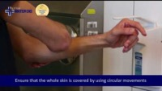

Slide 10
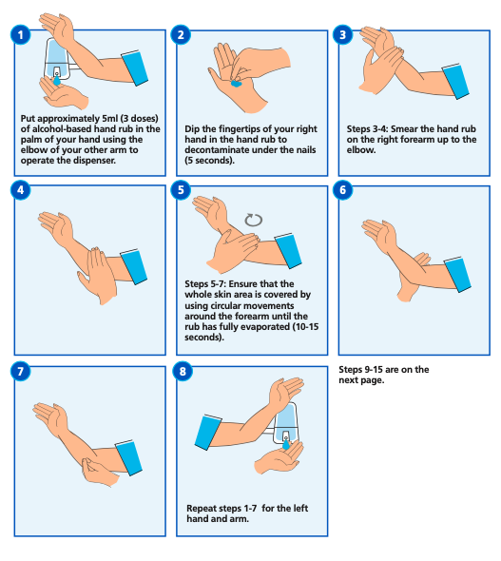
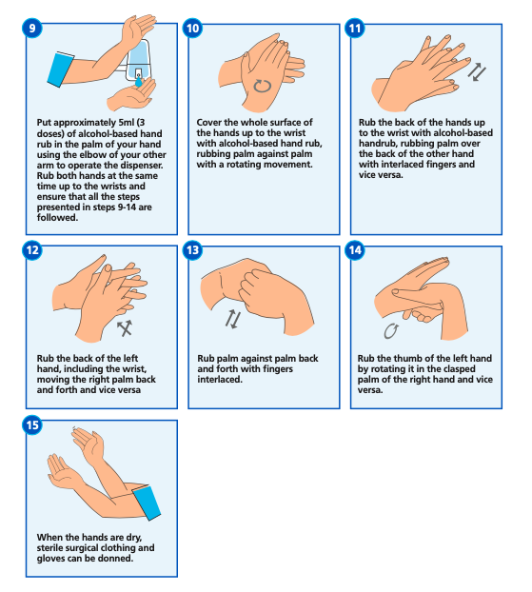
Source: https://www.england.nhs.uk/publication/national-infection-prevention-and-control-manual-for-england-appendices/#heading-4
Notes:
Source: https://www.england.nhs.uk/publication/national-infection-prevention-and-control-manual-for-england-appendices/#heading-4

Slide 11

Re-Audit | Basic
XX(XX%)
used water-based
hand washing
XX(XX%)
used ABHR
XXXX including XXXX
operating cases scrubbing episodes
This represents a saving of
XXXX litres of water per year
Insert table / graph from spreadsheet calculations
Notes:
Delete this slide (BASIC AUDIT) or next one (ADVANCED AUDIT) as required on basis of what model was used.
BASIC RE-AUDIT
Data for the blank spaces (boxes left to right from top) FOUND ON TAB 1 OF THE SPREADSHEET, however beware cells indicated below are correct when referring to original spreadsheet but will be different if you insert rows/columns etc::
Number of operating cases that you have re-audited (cell D33)
Total number of scrubbing episodes (cell C33)
Number of episodes using water-based hand washing (cell E33; and percentage which is calculated by (E33)/C33 x 100)
Number of episodes using ABHR (cell F33; and percentage which is calculated by F33/C33 X 100)
GRAPH – (optional! You can choose which value you feel is more representative to demonstrate results in a graph – e.g., per case, scrub, year etc.
Litres of water saved in the department extrapolated to a year (cell K11)

Slide 12
Re-Audit | Advanced
XX(XX%)
used traditional
hand washing
XX(XX%)
used ABHR
XXXX including XXXX
operating cases scrubbing episodes
We have saved
XXXX litres of water per year
Insert table / figure from spreadsheet calculations
with a carbon footprint equivalent
to driving XXX miles in a petrol car!
Notes:
Delete this slide (ADVANCE AUDIT) or previous one (BASIC AUDIT) as required on basis of what model was used.
ADVANCED RE-AUDIT
Data for the blank spaces (boxes left to right from top) FOUND ON TAB 2 OF THE SPREADSHEET, however beware cells indicated below are correct when referring to original spreadsheet but will be different if you insert rows/columns etc:
Number of operating cases that you have re-audited (cell C33)
Total number of scrubbing episodes (cell D33)
Number of episodes using water-based hand washing (sum of values in cells F33 + G33; and percentage which is calculated by (F33+G33)/C33x 100))
Number of episodes using ABHR (cell E33;and percentage which is calculated by E33/C33 X 100)
GRAPH – (optional! You can choose which value you feel is more representative to demonstrate results in a graph – e.g., per case, scrub, year etc. (results in O7-9, P7-9, Q13-15)
Litres of water saved in the department extrapolated to a year (cell Q13)
Estimated carbon footprint savings in the department extrapolated to a year (cell Q14; choose any useful comparison, this is a good website to find them: https://www.epa.gov/energy/greenhouse-gas-equivalencies-calculator

Slide 13
This represents a saving of
XXXX pounds per year
Notes:
ADVANCED RE-AUDIT
Data for the blanked-out figure is in cell Q15, ON TAB 2 OF THE SPREADSHEET, however beware cells indicated are correct when referring to original spreadsheet but will be different if you insert rows/columns etc:

Slide 14

References
Slide 3
NICE 2020. Surgical site infections: prevention and treatment (NG125). Available at: https://www.nice.org.uk/guidance/ng125
World Health Organisation 2009. WHO Guildeines on Hand Hygeine in Health Care. Available at: https://www.who.int/publications/i/item/9789241597906
Wormer BA, Augenstein VA, Carpenter SL, et al. The green operating room: simple changes to reduce cost and our carbon footprint. Am Surg 2013; 79: 666–671.
United Nations Department of Economic and Social Affairs (UNDESA) 2015. International Decade for Action ‘Water for Life’; Water and Sustainable Development. Available from: https://www.un.org/waterforlifedecade/water_and_sustainable_development.shtml
Parienti JJ, Thibon P, Heller R, et al. Hand-rubbing with an aqueous alcoholic solution vs traditional surgical hand-scrubbing and 30-day surgical site infection rates:
a randomized equivalence study. JAMA 2002;288(6):722-727.
Tanner J, Dumville JC, Normal G, Fortnam M. Surgical hand antisepsis to reduce surgical site infection. Cochrane Database of Systematic Reviews 2016; 1: Article CD004288
Lopes AER, Menegueti MG, Gaspar GG, et al. comparing surgeons’ skin tolerance and acceptability to alcohol-based surgical hand preparation vs traditional surgical scrub: a matched quasi-experimental study. Am J Infect Control 2020;50(10):1091-1097.
Slide 9
Source: https://www.england.nhs.uk/publication/national-infection-prevention-and-control-manual-for-england-appendices/#heading-4

Slide 15

Thank you
RCS Green Theatre Checklist
E-Quip series
Notes:
A closing slide maybe please?

