Slide 1
Undermining and Bullying in the Surgical Workplace

Slide 2
The problem
Bullying happens in all walks of life, in most medical specialties, and between clinical and non-clinical staff
Whilst surgeons are not the only bullies, there is evidence to suggest that it is particularly prevalent in our specialty
Not only is this unpleasant for us, there is evidence to show it can cause harm to our patients
The aim of our campaign is to offer support to those being bullied, help identify bullying behaviour in ourselves, and to lead by example by changing the culture in the surgical workplace

Slide 3
Definitions
GMC
‘Undermining is behaviour that subverts, weakens or wears away confidence’
‘Bullying is behaviour that hurts or frightens someone who is less powerful, often forcing them to do something they do not want to do’
ACAS
‘Victimisation is retaliatory action by an employer against an employee who has made or supported a complaint of discrimination’

Slide 4
Examples of Undermining
Public comments:
  laziness
  incompetence
  belittling
Preventing access to leave, training, opportunity
Applying excessive pressure, setting impossible deadlines
Removing responsibility, failing to give credit, frequent reminders of failure / poor performance
Notes:
Deliberate undermining seeks to diminish an individual’s reputation. In general, undermining behaviour results in individuals feeling excluded, drained of confidence, potentially harassed to the point that their work and psychological health suffer. However, there can be instances where although the trainee feels undermined, the trainer may feel they are maintaining high standards. It takes skill to define exactly what is going on. From a victim’s point of view, it is usually helpful to seek an objective opinion from a third party.
Also important to state that bullying and undermining rarely exist in isolation, they are often experienced together, but we have defined them here separately, for clarity.

Slide 5
Examples of Bullying
Aggressive behaviour, shouting, threatening, physical and/or sexual intimidation
Humiliating colleagues in front of staff, patients
Aggressive communication (verbal or electronic)
Spreading malicious rumours
Threats to limit career progression
Notes:
In short, bullying is intimidation designed to frighten and hurt individuals, and to establish or widen a harmful power differential.

Slide 6
Examples of Victimisation
Excluding an employee from work-related activities
Denying promotion
False allegations
Dismissal
Threats to do any of the above
Notes:
In response to an individual making or supporting an allegation of discrimination, these behaviours would be classed as victimisation. However, if the allegation was not made in good faith, or was false, then victimiations cannot have been said to have occurred.

Slide 7
Bullying in the NHS
Source | N, Participant type | Perceive they have been bullied | Have witnessed bullying of a colleague | Felt able to report bullying
GMC (2014) | 53,077 Trainee doctors (all specialties) | 4,246 (8.0%) | 7,272 (13.7%) | 531 (1.0%)
Carter et al. 2015 BMJ Open 3(6):e002628 | 2,950 NHS medical and non-medical staff | 590 (20.0%) | 1,269 (43.0%) | 80-422 (2.7-14.3%)*
RCSEd (2015) | 1,049 Members and Fellows | 357 (34%) | 388 (37%) | 346 (33%)
* Depending on the type of bullying
Notes:
All studies show that victims or witnesses do not report most bullying, despite the high incidence. This suggests that systems are not yet robust enough to give confidence to victims or witnesses.
RCSEd’s Survey of Members and Fellows found that only 28% of responders felt that the current NHS reporting system was satisfactory.

Slide 8
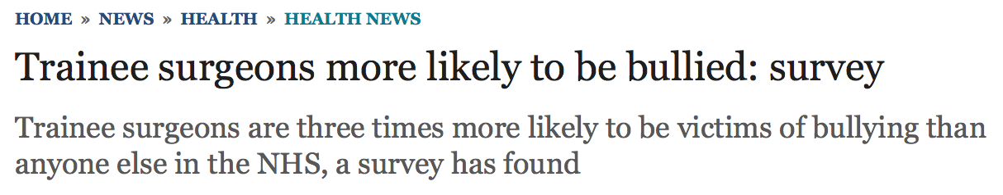
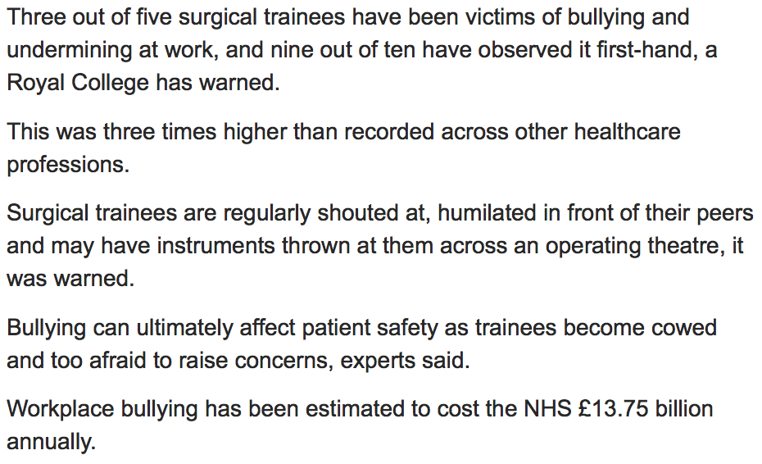
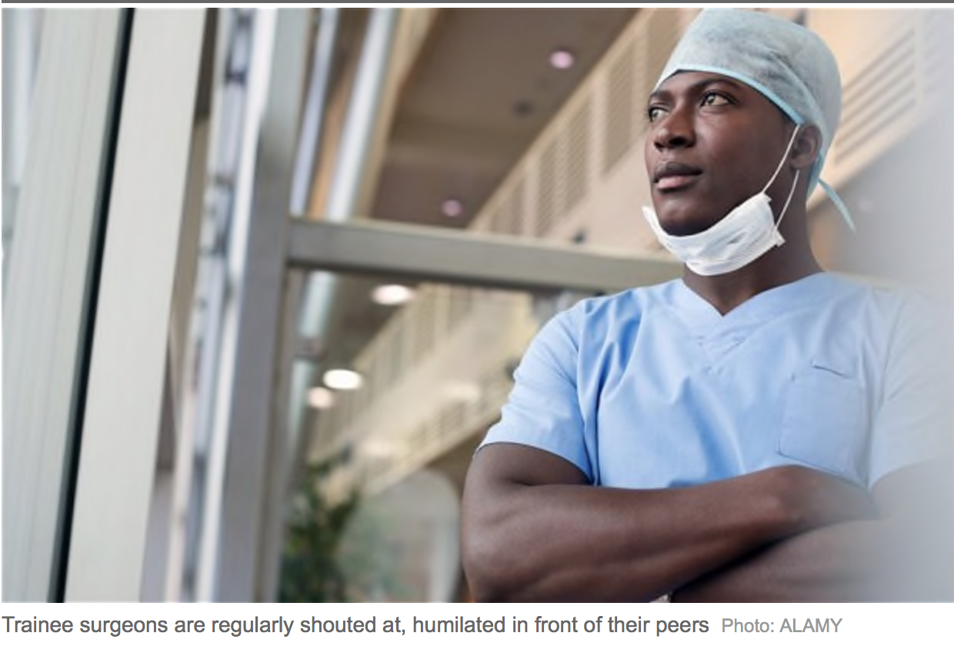
Notes:
RCOG have responded to high levels of bullying in O&G by developing the role of Workforce Behaviour Champion, and by attempting to provide more visible support for victims.
Surgeons need to follow this example as the data suggests we also have a significant problem. This is also in the public domain and threatens our professional standing and the public’s confidence.

Slide 9
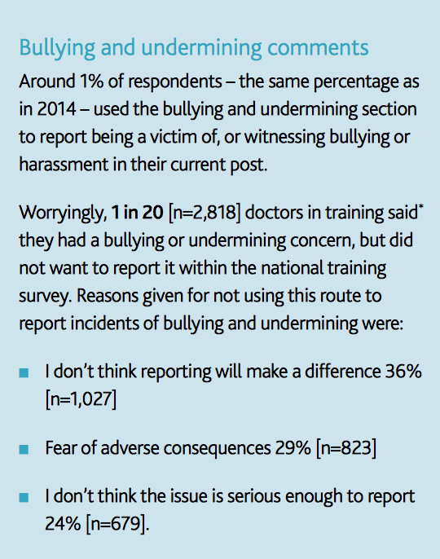
GMC Trainees’ Survey 2016
Notes:
Bullying reporting continues to be lower than the overall reported incidence.
Surgeons have a duty (as do other relevant parties such as Trusts, Deaneries, GMC etc) to correct the victim’s / witness’s perceived cost-benefit imbalance of reporting bullying.

Slide 10
The Law
Allegation | Act of Parliament | Remedy | Punition
Bullying | None | None | None
Undermining | None | None | None
Harassment | Equality Act 2010 | Employment Tribunal | Compensation
 | Criminal Justice and Public Order Act 1994 | Criminal prosecution | Up to 6 months custodial sentence and/or £5,000
 | Protection From Harassment Act 1997 | Criminal prosecution ‘beyond reasonable doubt’ or Civil case ‘on the balance of probability’ | Up to 6 months custodial sentence and/or £5,000 Up to £30,000
Consider whether your case could be defined as harassment
Notes:
Speaker should point out that although bullying is not a crime, individuals who are victims of bullying should consider whether they are being harassed, as per the definition on Slide 11.
Equally important, it should be emphasised that although it is not illegal, it is still unacceptable and should be reported (which will be discussed later).

Slide 11
Harassment
“Unwanted conduct related to a relevant protected characteristic*, which has the purpose or effect of violating an individual’s dignity or creating an intimidating, hostile, degrading, humiliating or offensive environment for that individual”.
*Age, disability, gender reassignment, race, religion or belief, sex and sexual orientation, marriage or civil partnership, pregnancy or maternity.
Equality Act 2010
Notes:
Need to emphasise that these are illegal behaviours legislated against in a variety of anti-discrimination acts.

Slide 12
Employment Tribunals
Key features
Deal with unfair dismissal, redundancy, discrimination
Claim has to be made within 3 months less one day
Costs £390-1200 to make a claim
Claimant not liable for costs, even in defeat
Maximum award of £74,200 for unfair dismissal, no maximum award for discrimination

Slide 13
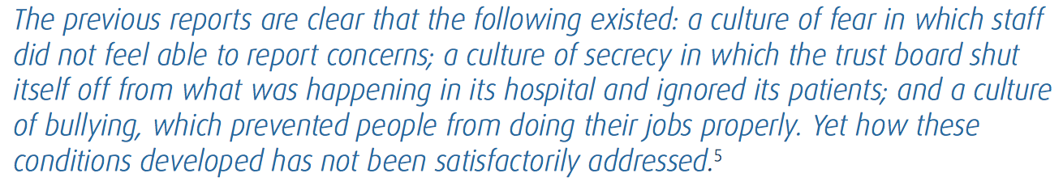
The Effects of Bullying
Effect on patient care: The Francis Report 2013
Notes:
Greater deviations away from zero show stronger positive correlations (positive numbers), and stronger negative correlations (negative numbers). All are statistically significant.
Use this data to show that bullying reduces staff availability and threatens recruitment and retention of staff – again, another threat to patient safety.

Slide 14
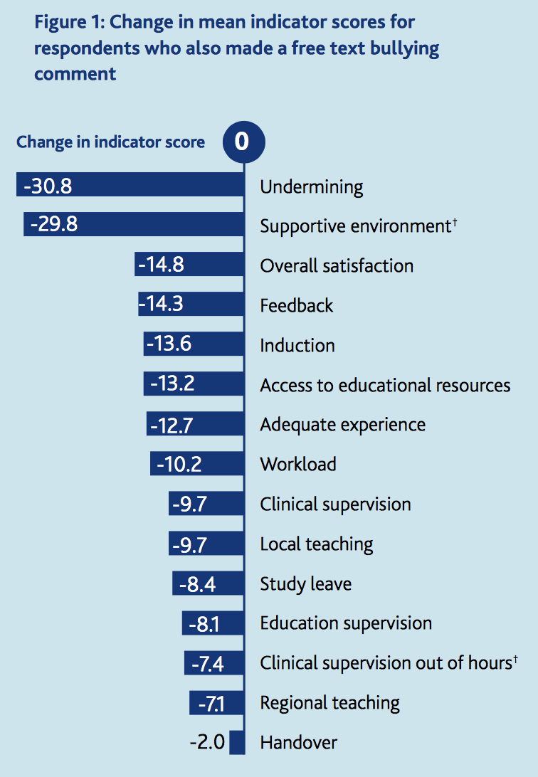
The Effects of Bullying
GMC Survey 2014
‘0’ is mean survey score for all responders
n = 52,599
Notes:
This data is taken from the GMC Training Survey 2014.
The baseline represents the mean scores across the cohort. The change in indicator score represents the difference between mean scores for those who reported bullying in the free text part of the survey versus the whole cohort, for different aspects of training.

Slide 15
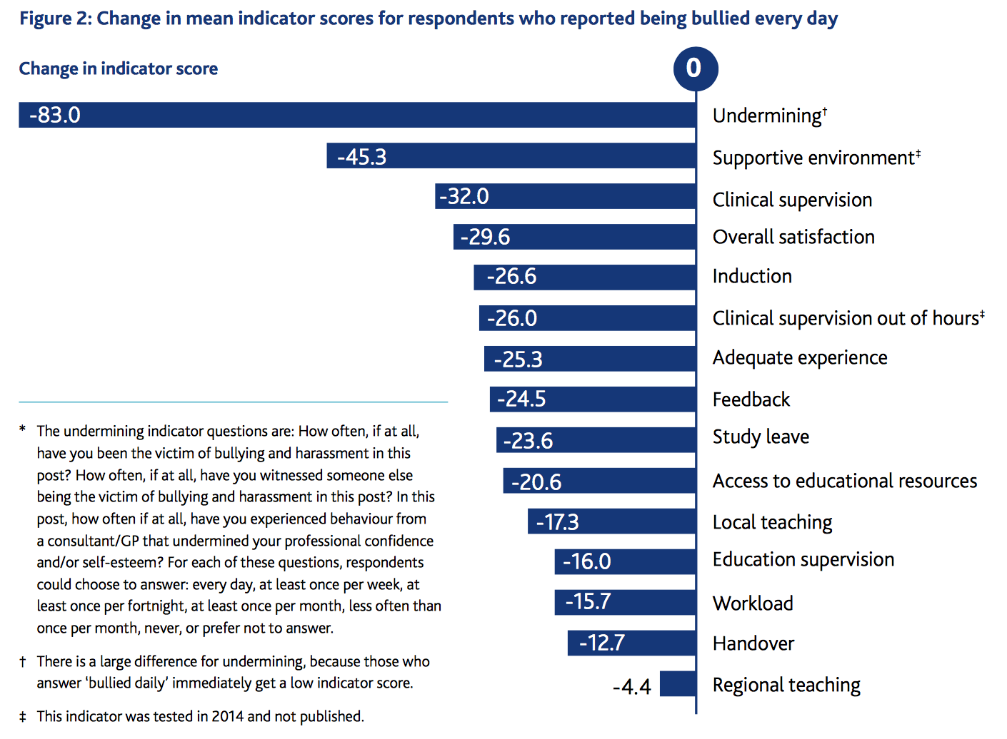
Notes:
Similar data, this time for those who reported being bullied every day. The differences are clearly greater.

Slide 16
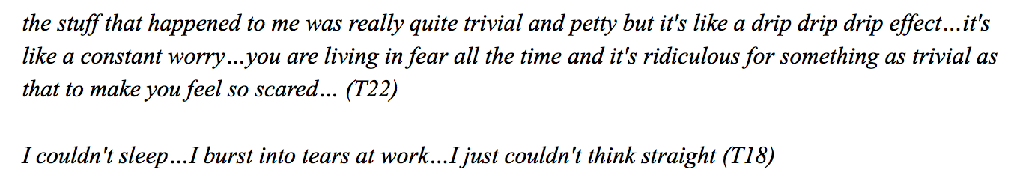
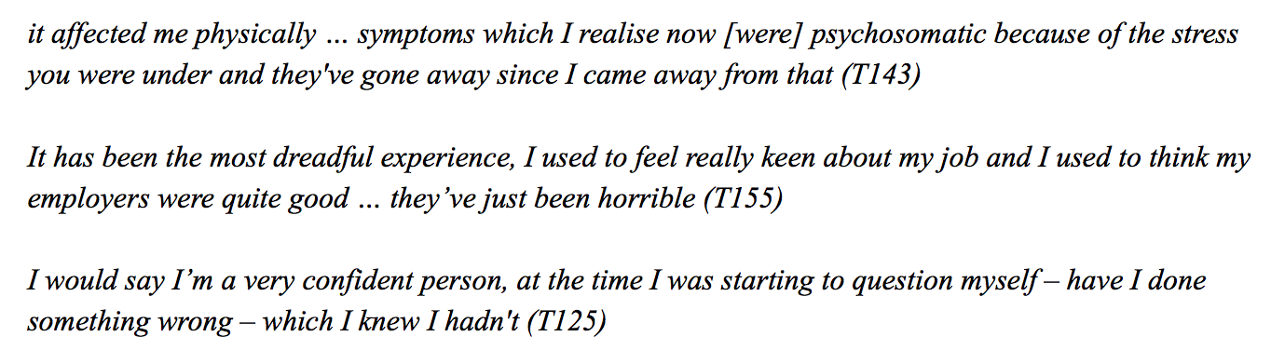
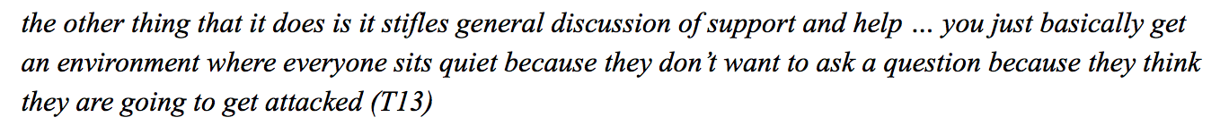
The Effects of Bullying
Carter et al. BMJ Open 3(6): e002628
Notes:
Qualitative data from survey of 41 interviews, as referenced.
Again, emphasise threat to patient safety as inferred by final statement.

Slide 17
Employers’ Responsibilities
Employers have a duty of care for their employees
Potential remedies
Harassment – Employment tribunal
Constructive dismissal can be alleged
Health risk – Health and Safety Act 1974
Breach of contract can be alleged
Notes:
Employers have a ‘duty of care’ for all their employees. If the mutual trust and confidence between employer and employee is broken – for example through bullying and harassment at work – then an employee can resign and claim constructive dismissal ,at an Employment Tribunal, on the grounds of breach of contract (as long as they have worked for the employer for two years). Employers are usually responsible in law for the acts of their workers. (Taken from ACAS website).
Breach of contract may also include the failure to protect an employee’s health and safety at work. Under the Health and Safety at Work Act 1974, employers are responsible for the health, safety and welfare at work of all employees. (ACAS website).

Slide 18
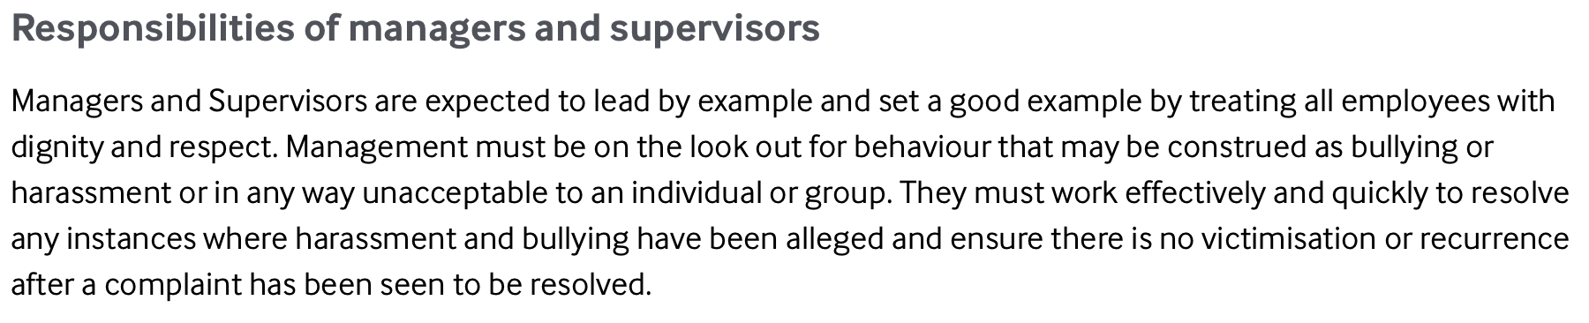
Managers’ Responsibilities
BMA advice
As current or future consultant surgeons you will lead departments and surgical teams
It is essential that personal practice becomes consistent with these responsibilities at an early stage
Notes:
Should be emphasised that all trainee surgeons are future leaders and managers, and so should be aware of the responsibilities of that role at an early stage.

Slide 19
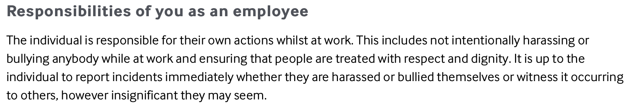
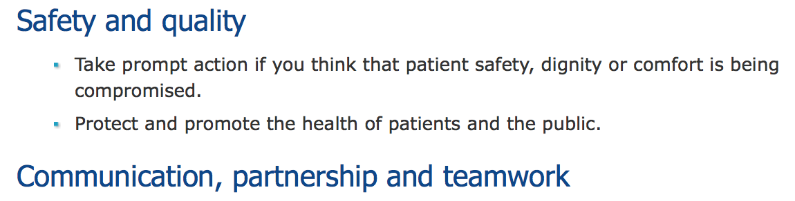
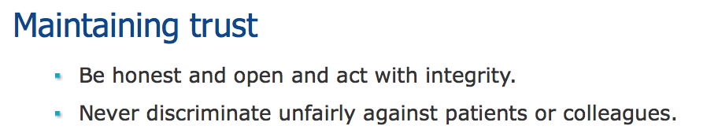
Doctors’ Responsibilities
BMA advice
GMC duties of a doctor
Are you fit to practise?
Notes:
As doctors, we all have a responsibility to uphold the standards defined in the GMC’s ‘Duties of a doctor’.
This includes reporting the bullying, undermining and harassment of others. Failure to do this may lead to fitness to practice investigations.

Slide 20
Taking Action – Culture Change
Reactive Interventions | Proactive Interventions
GMC National Training Survey follow up | Trainee forums and regular surveys
Quality panels | Regular senior management and junior staff meetings
Monitoring visits | Mentoring
Referral to professional support bodies | Schwartz rounds and safety huddles
Human Resources procedures | GMC, College and Faculty guidance
Mediation between those in conflict | Departmental away days, Trainer/Manager of the Month
STOPIT and TrACE style courses | Resilience training
AoMRC ‘Creating Supportive Environments’ 2016
Notes:
These are interventions (both reactive and proactive) currently used, as identified by doctors attending the AoMRC’s ‘Creating Supportive Environments’ event in 2016.
STOPIT = workplace / school bullying anonymous reporting software
TrACE = Training and Assessment in the Clinical Workplace course (RCSEng). Designed for senior trainees to prepare for becoming a team leader / training supervisor.
Schwartz Rounds = offer healthcare providers a regularly scheduled time to discuss the social and emotional issues they face in caring for patients and families, and to share their experiences, thoughts and feelings on topics drawn from actual patient cases with colleagues from other healthcare disciplines. We are notoriously poor at addressing the emotional impact of surgical practice amongst team members. Other specialties do this much better.

Slide 21
Taking Action – Essentials
Document everything
  Every encounter should be recorded and can be used as evidence
Remain professional
Stick to the facts
Communicate
  Consider written communication if you don’t feel comfortable confronting the bully
Notes:
If you are being bullied, it is essential that you do these things, as they may be required as evidence in future disciplinary hearings / employment tribunals. When presenting this slide, emphasise that following this guidance is not excessive, nor is it representative of paranoia. It is merely a sensible means of self-protection.
Document everything – every form of written communication, every encounter where you have been bullied or have witnessed bullying of others, included times and dates. Even trivial episodes may cumulatively represent compelling evidence in a tribunal or other court hearing. Consider recording meetings (though you must make clear that you are recording, and offer the other parties a copy) and beware the ‘informal chat’.
Even in the most difficult circumstances it is essential that you remain professional. Failure to do so may compromise your legitimate complaint, and may lead to disciplinary action taken against you or patient safety risks. If you feel unable to maintain professionalism, or if you feel patient safety is at risk, you must elevate your concerns to senior clinical managers. Failure to do so may contravene GMC guidelines.
You must be accurate and honest in your representation of events. If your concerns are legitimate, it is unlikely that exaggeration or fabrication of incidents will be required, as the facts are often enough to support a compelling argument. Founded allegations of exaggeration or dishonesty will severely compromise your case in any formal hearing or court case.
It can be extremely difficult to communicate verbally with a bully, as by definition, you are being intimidated. Written communication expressing your concerns and requesting an end to such behaviour is a legitimate and sensible approach and can be used as evidence in future. It is also imperative to communicate with senior staff or management. Always seek advice and representation from a third party, such as BMA or MDU / MPS / MDDUS.

Slide 22
Stepwise Approach
Team
Clinical/educational Supervisor
Clinical Director
Organisation
Medical Director
Human Resources
External
Training Programme Director
BMA/GMC/CQC/Citizens Advice
The law – as a last resort
Notes:
Describe a stepwise approach to reporting bullying, either of yourself or a colleague. Emphasise that it is usually possible to solve problems at a local level without recourse to external bodies.
Legal action should only be considered as a last resort – each higher level that the case is taken to can confer greater stress to the individual, a lengthier investigation process, and more serious consequences for all involved.
However, if you are dissatisfied with the response, do not hesitate to take it to the next level as structures exist to support you.

Slide 23
‘There Appears to be a Lacuna’
Covered by Employment Act
Consultants
SAS doctors
Nurses
Student nurses
Allied health professionals
Agency staff
Result
No access to employment tribunal for 54,000 doctors
Trainee liable for costs
Not covered by Employment Act
Doctors in training
Lead
employer
Host Trust
HEE
Notes:
Slide to raise awareness that trainee doctors are not necessarily covered in English Law by the Employment Act (legal position for other jurisdictions to be confirmed). The case of Dr Chris Day confirms that trainees may fall through a ‘lacuna’ (term used by the judge at the review) if they seek an employment tribunal to claim constructive dismissal against their Deanery.
This is due to three bodies playing a role in their employment:
1. The host trust at which the allegations are claimed to have occurred (which may not be the lead employer, and therefore it has no role as an employer).
2. The lead employer trust (usually responsible for employer admin such as pay slips etc., but not necessarily the Trust where the alleged behaviour took place).
3. HEE (Previously known as ‘the Deanery’) – they do not pay a salary, nor do they claim to employ individual trainees. Chris Day’s claim was that they act as an employment agency as they arrange placements, appoint doctors to training programmes and undertake the ARCP process, but this was successfully refuted by HEE. This excludes them from employment law.
In short, if a trainee tries to take his or her Deanery to an employment tribunal they cannot do so. The high court is their only option, which puts them at risk of liability for costs should they lose the case. In employment tribunals, the losing claimant is exempt from costs if their case is not judged to be spurious.

Slide 24
Reporting Bullying is Difficult
Often easier to do nothing
Always wrong to do nothing
Essential to get support
If nothing else, personal vindication
Can discuss with Hospital Staff Committee, Local Negotiating Committee, and the law (easier than you think)
Notes:
Important not to suggest that reporting bullying and undermining is easy – patently it is not. The cost-benefit to the individual, whether reporting as a victim or as an observer, is usually intimidating.
However, you will be vindicated and (at least) have moral satisfaction if you do the right thing.
The only way to change the culture is to report, report, report.

Slide 25
Are You a Bully?
Ask yourself the question…
If the answer is yes:
Complete the eModule
Discuss with colleagues
Apologise
No surgeon is beyond redemption – we want you to change

Slide 26
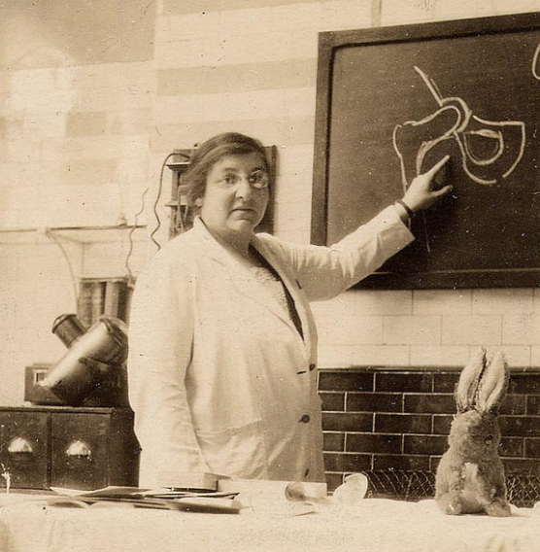
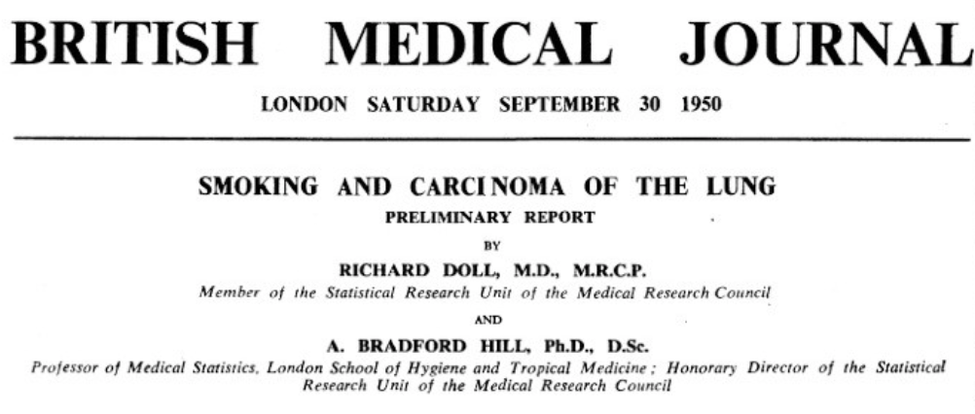
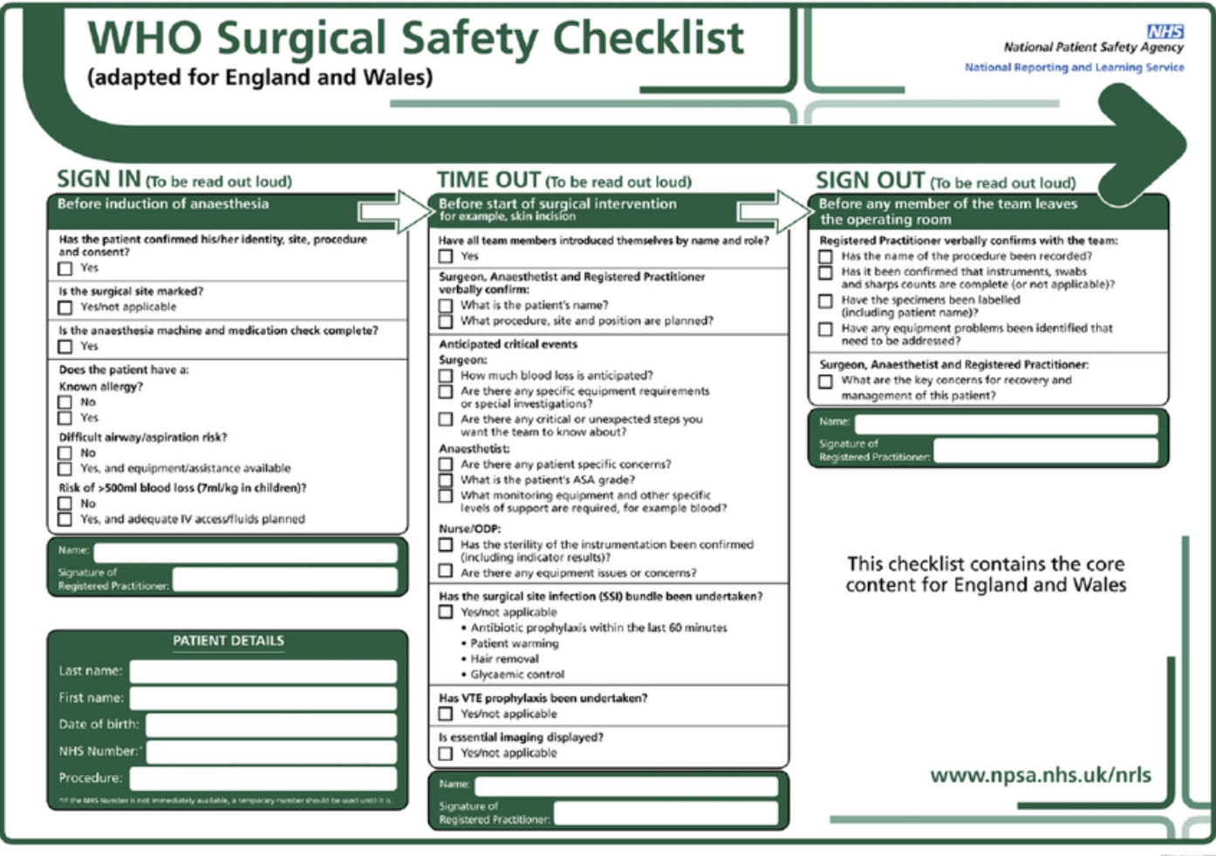
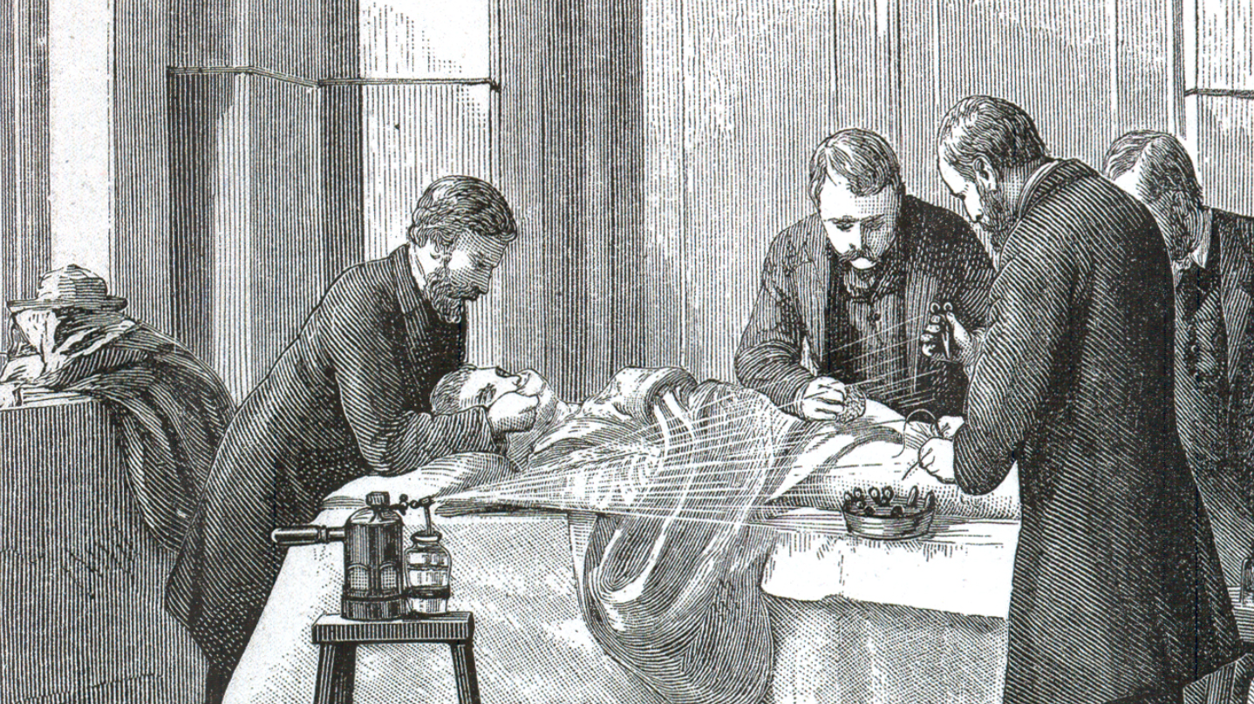
Tipping Points
Notes:
Key message of slide: many things were considered ‘acceptable’ until somebody thought otherwise.
Clockwise:
Sexual discrimination in surgery considered acceptable: Gertrude Herzfeld (FRCS 1920, 415 years after the College’s inception) – first female practicing Fellow of RCSEd, 30% of surgical trainees now female (and climbing)
Smoking initially considered beneficial to health: Richard Doll’s paper defining the association between smoking and carcinoma of the lung
Post-operative infections thought to come from the air, with surgeons operating in unwashed gowns to flaunt their experience and bravura – the ‘good old surgical stink’: Lister spraying phenol antiseptic on a surgical patient in Edinburgh to reduce post-operative infection by skin commensal flora
Modern surgical practice considered safe: WHO Surgical Safety Checklist reduces peri-operative mortality and morbidity

Slide 27
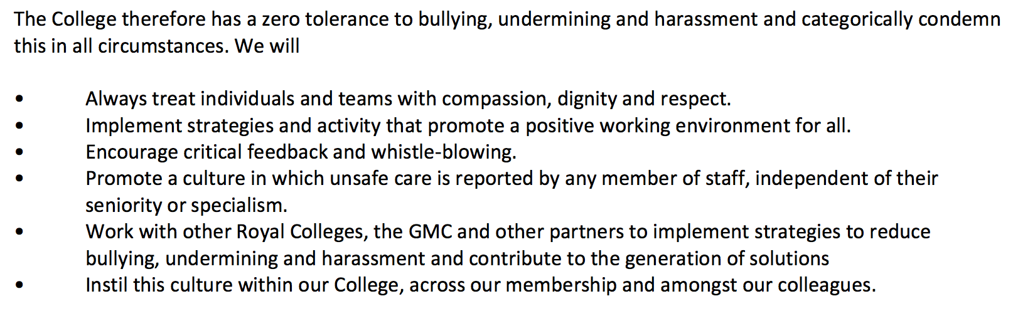
The Role of the RCSEd
Notes:
College’s position statement on bullying and undermining.

Slide 28
Key Messages
Bullying and undermining behaviour is never acceptable
It threatens patient safety
It is not part of surgery
Report it properly – follow our guidance
RCSEd will lead a culture change
Notes:
Summary of key messages

