Slide 1
Undermining and Bullying in the Surgical Workplace

Slide 2
The problem
Bullying happens in all walks of life, in most medical specialties, and between clinical and non-clinical staff
Whilst surgeons are not the only bullies, there is evidence to suggest that it is particularly prevalent in our specialty
Not only is this unpleasant for us, there is evidence to show it can cause harm to our patients
The aim of our campaign is to offer support to those being bullied, help identify bullying behaviour in ourselves, and to lead by example by changing the culture in the surgical workplace

Slide 3
Definitions
GMC
‘Undermining is behaviour that subverts, weakens or wears away confidence’
‘Bullying is behaviour that hurts or frightens someone who is less powerful, often forcing them to do something they do not want to do’
ACAS
‘Victimisation is retaliatory action by an employer against an employee who has made or supported a complaint of discrimination’

Slide 4
Bullying in the NHS
Source | N, Participant type | Perceive they have been bullied | Have witnessed bullying of a colleague | Felt able to report bullying
GMC (2014) | 53,077 Trainee doctors (all specialties) | 4,246 (8.0%) | 7,272 (13.7%) | 531 (1.0%)
Carter et al. 2015 BMJ Open 3(6):e002628 | 2,950 NHS medical and non-medical staff | 590 (20.0%) | 1,269 (43.0%) | 80-422 (2.7-14.3%)*
RCSEd (2015) | 1,049 Members and Fellows | 357 (34%) | 388 (37%) | 346 (33%)
* Depending on the type of bullying
Notes:
All studies show that victims or witnesses do not report most bullying, despite the high incidence. This suggests that systems are not yet robust enough to give confidence to victims or witnesses.
RCSEd’s Survey of Members and Fellows found that only 28% of responders felt that the current NHS reporting system was satisfactory.

Slide 5
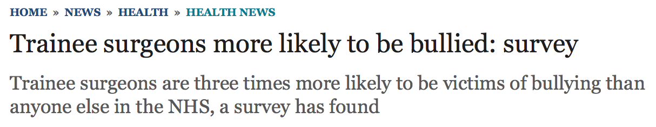
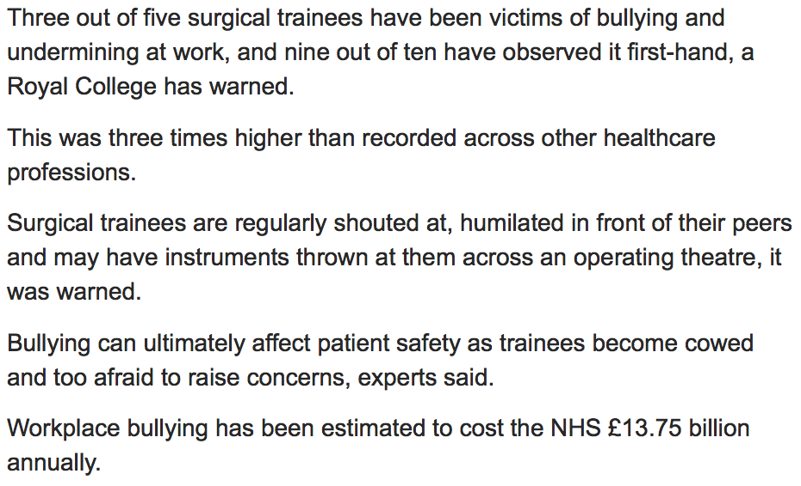
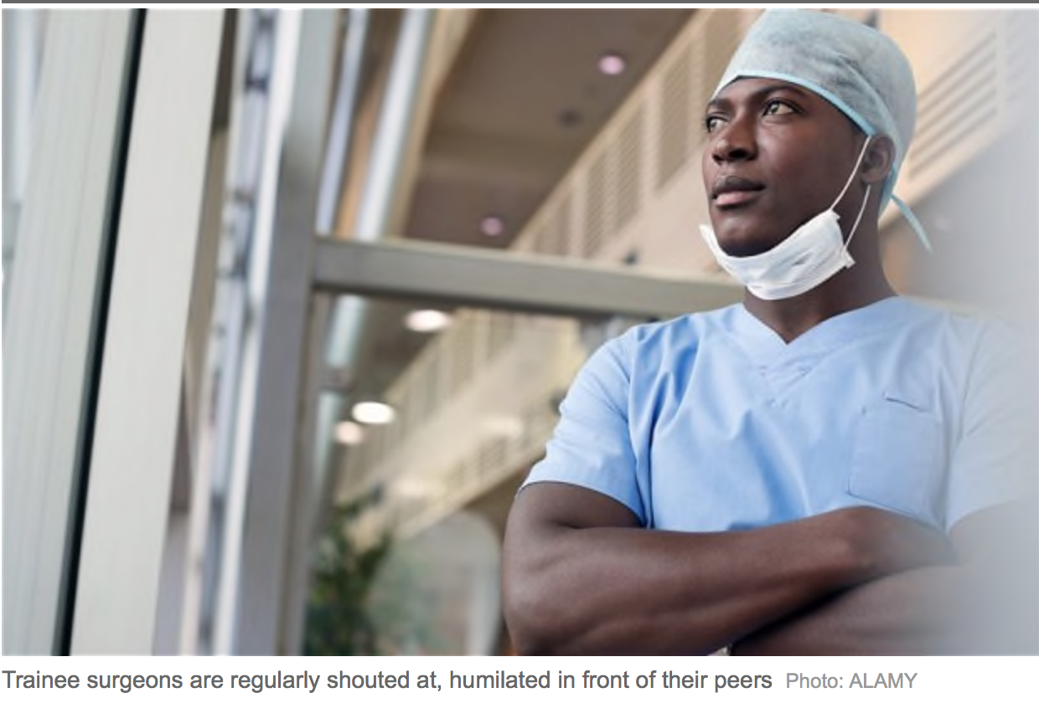
Notes:
RCOG have responded to high levels of bullying in O&G by developing the role of Workforce Behaviour Champion, and by attempting to provide more visible support for victims.
Surgeons need to follow this example as the data suggests we also have a significant problem. This is also in the public domain and threatens our professional standing and the public’s confidence.

Slide 6
The Law
Allegation | Act of Parliament | Remedy | Punition
Bullying | None | None | None
Undermining | None | None | None
Harassment | Equality Act 2010 | Employment Tribunal | Compensation
 | Criminal Justice and Public Order Act 1994 | Criminal prosecution | Up to 6 months custodial sentence and/or £5,000
 | Protection From Harassment Act 1997 | Criminal prosecution ‘beyond reasonable doubt’ or Civil case ‘on the balance of probability’ | Up to 6 months custodial sentence and/or £5,000 Up to £30,000
Consider whether your case could be defined as harassment
Notes:
Speaker should point out that although bullying is not a crime, individuals who are victims of bullying should consider whether they are being harassed, as per the definition on Slide 9.
Equally important, it should be emphasised that although it is not illegal, it is still unacceptable and should be reported (which will be discussed later).

Slide 7
Harassment
“Unwanted conduct related to a relevant protected characteristic*, which has the purpose or effect of violating an individual’s dignity or creating an intimidating, hostile, degrading, humiliating or offensive environment for that individual”.
*Age, disability, gender reassignment, race, religion or belief, sex and sexual orientation, marriage or civil partnership, pregnancy or maternity.
Equality Act 2010
Notes:
Need to emphasise that these are illegal behaviours legislated against in a variety of anti-discrimination acts.

Slide 8
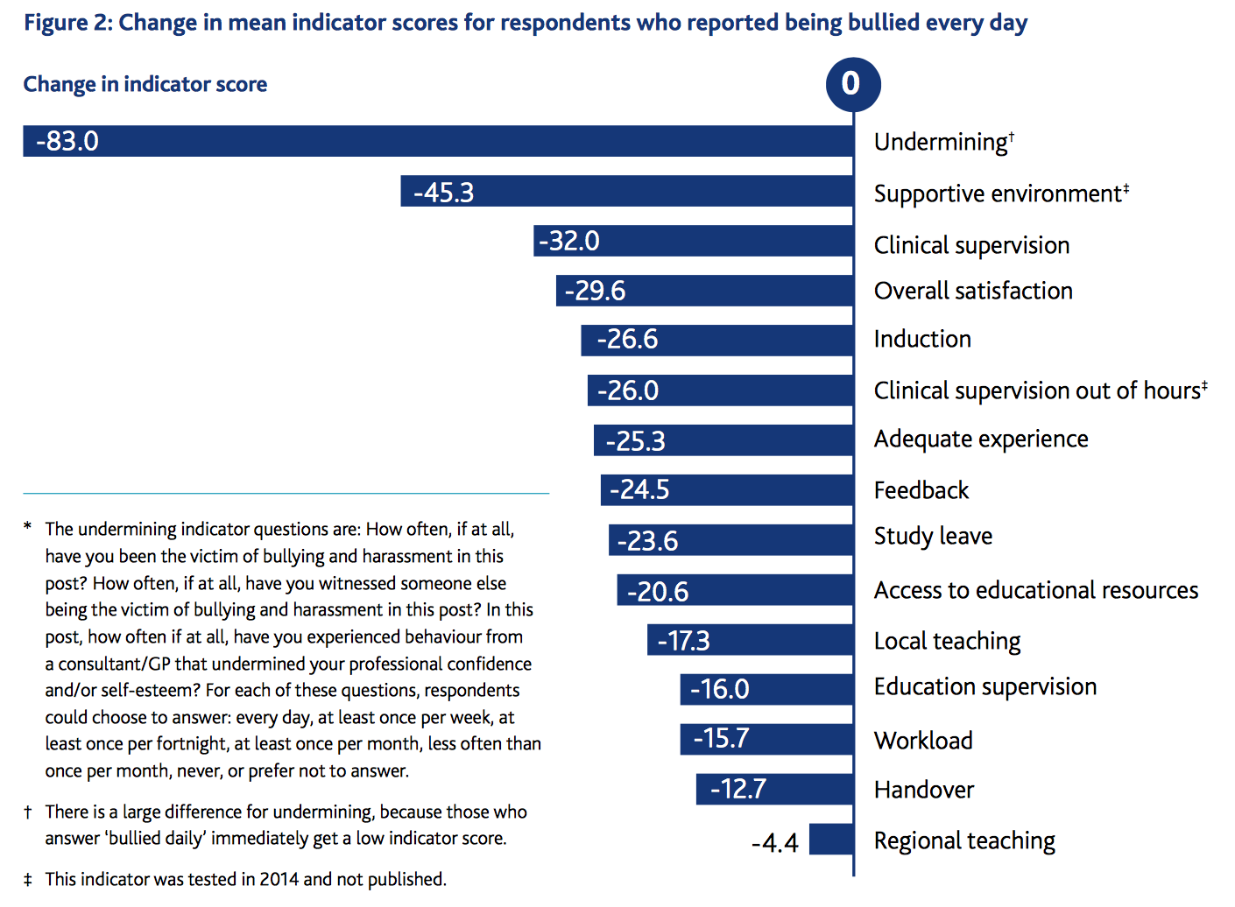
Notes:
This data is taken from the GMC Training Survey 2014.
The baseline represents the mean scores across the cohort. The change in indicator score represents the difference between mean satisfaction scores for those who reported being bullied every day, versus the whole cohort, for different aspects of training.

Slide 9
Taking Action – Culture Change
Reactive Interventions | Proactive Interventions
GMC National Training Survey follow up | Trainee forums and regular surveys
Quality panels | Regular senior management and junior staff meetings
Monitoring visits | Mentoring
Referral to professional support bodies | Schwartz rounds and safety huddles
Human Resources procedures | GMC, College and Faculty guidance
Mediation between those in conflict | Departmental away days, Trainer/Manager of the Month
STOPIT and TrACE style courses | Resilience training
AoMRC ‘Creating Supportive Environments’ 2016
Notes:
These are interventions (both reactive and proactive) currently used, as identified by doctors attending the AoMRC’s ‘Creating Supportive Environments’ event in 2016.
STOPIT = workplace / school bullying anonymous reporting software
TrACE = Training and Assessment in the Clinical Workplace course (RCSEng). Designed for senior trainees to prepare for becoming a team leader / training supervisor.
Schwartz Rounds = offer healthcare providers a regularly scheduled time to discuss the social and emotional issues they face in caring for patients and families, and to share their experiences, thoughts and feelings on topics drawn from actual patient cases with colleagues from other healthcare disciplines. We are notoriously poor at addressing the emotional impact of surgical practice amongst team members. Other specialties do this much better.

Slide 10
Taking Action – Essentials
Document everything
  Every encounter should be recorded and can be used as evidence
Remain professional
Stick to the facts
Communicate
  Consider written communication if you don’t feel comfortable confronting the bully
Notes:
If you are being bullied, it is essential that you do these things, as they may be required as evidence in future disciplinary hearings / employment tribunals. When presenting this slide, emphasise that following this guidance is not excessive, nor is it representative of paranoia. It is merely a sensible means of self-protection.
Document everything – every form of written communication, every encounter where you have been bullied or have witnessed bullying of others, included times and dates. Even trivial episodes may cumulatively represent compelling evidence in a tribunal or other court hearing. Consider recording meetings (though you must make clear that you are recording, and offer the other parties a copy) and beware the ‘informal chat’.
Even in the most difficult circumstances it is essential that you remain professional. Failure to do so may compromise your legitimate complaint, and may lead to disciplinary action taken against you or patient safety risks. If you feel unable to maintain professionalism, or if you feel patient safety is at risk, you must elevate your concerns to senior clinical managers. Failure to do so may contravene GMC guidelines.
You must be accurate and honest in your representation of events. If your concerns are legitimate, it is unlikely that exaggeration or fabrication of incidents will be required, as the facts are often enough to support a compelling argument. Founded allegations of exaggeration or dishonesty will severely compromise your case in any formal hearing or court case.
It can be extremely difficult to communicate verbally with a bully, as by definition, you are being intimidated. Written communication expressing your concerns and requesting an end to such behaviour is a legitimate and sensible approach and can be used as evidence in future. It is also imperative to communicate with senior staff or management. Always seek advice and representation from a third party, such as BMA or MDU / MPS / MDDUS.

Slide 11
Stepwise Approach
Team
Clinical/educational Supervisor
Clinical Director
Organisation
Medical Director
Human Resources
External
Training Programme Director
BMA/GMC/CQC/Citizens Advice
The law – as a last resort
Notes:
Describe a stepwise approach to reporting bullying, either of yourself or a colleague. Emphasise that it is usually possible to solve problems at a local level without recourse to external bodies.
Legal action should only be considered as a last resort – each higher level that the case is taken to can confer greater stress to the individual, a lengthier investigation process, and more serious consequences for all involved.
However, if you are dissatisfied with the response, do not hesitate to take it to the next level as structures exist to support you.

Slide 12
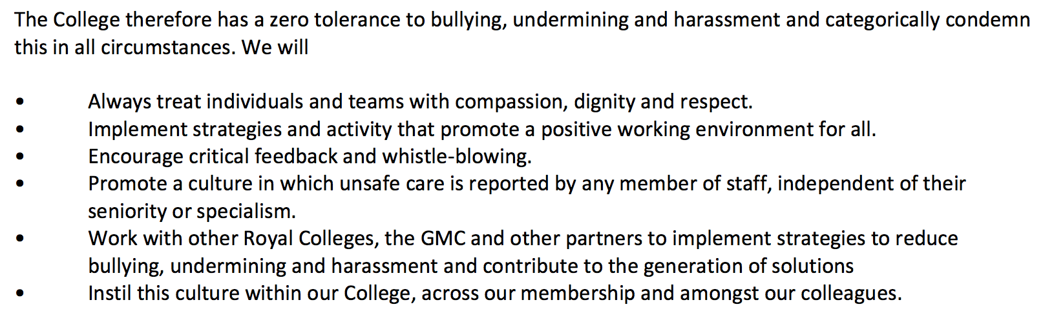
The Role of the RCSEd
Notes:
College’s position statement on bullying and undermining.

Slide 13
Key Messages
Bullying and undermining behaviour is never acceptable
It threatens patient safety
It is not part of surgery
Report it properly – follow our guidance
RCSEd will lead a culture change
Notes:
Summary of key messages

